Slide 1
Bias, Fairness and Transparency
Miranda Mowbray

Slide 2
With great power comes great responsibility
Notes:
Just because this was said by a cartoon character doesn’t mean it isn’t true
(It was said by Uncle Ben in the Spiderman comics)

Slide 3
Bias, fairness and transparency
Bias, unfairness in this session:
Systematic unwanted outcomes for a particular demographic group
(not statistical bias or inductive bias)
Transparency in this session:
focus is mostly on communication to stakeholder about how decision algorithm works.
Other aspects of transparency - see Ethics guidelines for Trustworthy AI
Notes:
Statistical bias is when your attempts to hit a target go systematically to the right. The unit programme asks whether inductive bias is always a bad thing. It isn’t. Inductive bias is the simplifications made in the model. All models are biased because they’re all simplifications of the real picture, but some are useful because their simplifications lead quickly to reasonably accurate results. So inductive bias can be a good thing.
Anyway, what I’ll be talking about in this session is demographic bias.

Slide 4
This session includes
- COMPAS - predictive analytics in criminal justice example
- Bias based on non-protected characteristics (Abby)
- Potential caste bias (Ed)
- Bias exaggeration example (Gonzálo)
- Some references for debiasing methods
- Sources of algorithmic bias
- Transparency for ensemble methods (Tom)
- Tenant screening example
Virtual office hour: email me
Slides, with references, will be available
Notes:
I have a virtual office hour: email me if you’d like to ask about or discuss anything in my sessions, and I’ll fix up a time to talk with you, probably by Zoom.
Thanks to all of you who suggested topics.

Slide 5
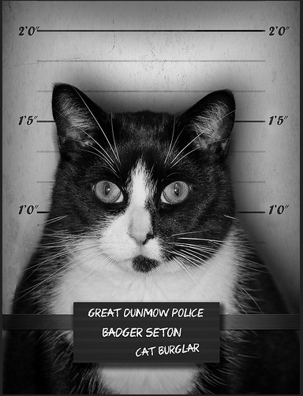

COMPAS ALGORITHM
Mark Seton / markseton on Flickr
https://www.flickr.com/photos/markseton/10766023213/
Notes:
I’ll talk now about recidivism prediction, in which a predictive algorithm decides whether or not a convicted criminal (like this cat burgler) is at high risk of being rearrested if they’re freed on parole, so as to help a parole board decide whether they need to continue to be locked up or whether they can be released. I’ll be talking about a particular algorithm called COMPAS that is used for this in several parts of the United States. (It was designed for use in determining parole. Contrary to the designers’ wishes, it’s also been used to support sentencing in some States.)

Slide 6
Objections to this sort of algorithm
Distracts from the big issue: US incarceration rate
- One of world’s highest, 3.6 x rate for England & Wales
World Prison Brief, May 2024
Predicts re-arrest, not re-offending
marijuana possession arrests biased against Black Americans
arrests for violent crimes perhaps not
Jennifer Skeem & Christopher Lowenkamp, 2016
Notes:
Before I go into the detail, I’d like to talk about two broader-scale objections to this sort of algorithm. The first is that thinking about the design of this algorithm is a distraction from the big problem of the very high US incarceration rate. The US incarceration rate is 3.6 times as large as that for England and Wales, and England and Wales has a high rate compared to most countries in mainland Europe. African-Americans are highly over-represented in the US prison population.
My take on this objection is that just because there are big problems in the world doesn’t mean that you shouldn’t consider any small problems. But talking in general, if you’re looking an ethical issue it’s right to consider the wider ethical context. You don’t want to find yourself designing beautifully unbiased code for a company whose basic business model makes you feel queasy.
The second objection is that the data on which the code to make the prediction is trained can only come from people who have been arrested. There are reasons to believe that an African-American who commits a crime is more likely to be arrested than a White American who commits a crime, making the input data exaggerate the recidivism rate for African-Americans. Well, there’s good evidence that that’s the case for arrests for possession of marijuana. However, the criminologists Skeem and Lowenkamp say that it seems not to be for arrests for violent crimes. The distribution of the ethnicity of the perpetrator for arrests for violent crimes is in line with the distribution of the perpetrator in victim reports for violent crimes, and there’s also some other evidence supporting the suggestion that although US drug policing has systemic racism, policing for violent offences doesn’t. There’s still some uncertainty over this though, for instance there may be disparities in the reporting of crimes that affect the numbers. So, perhaps we should only do this prediction for violent crimes. Let me say that I’m not a criminologist, Skeemm and Lowenkamp are.
For this reason, Predpol, which does predictive policing, excludes traffic violations and drug related offences (and uses “primarily victim data”). https://blog.predpol.com/machine-learning-and-policing
Speaking in general, when you’re doing machine learning you should think about where your input data comes from and the extent to which you can rely on it, and whether there are things you can do to make it more reliable. It may be that the data is so bad that you want to avoid the task altogether, or limit it to particular subcases where there’s better data.

Slide 7
False negatives vs false positives
Tradeoff between false negatives and false positives
You can’t minimize both
Policy decision
More important to prevent future crime,
or prevent unnecessary incarceration?
Notes:
In predictive analytics, except in trivial cases, you can’t minimize both false negatives and false positives. In the case of recidivism prediction, false negatives mean more crimes, false positives more unnecessary incarceration. You have to choose how to weight these. Typically for recidivism prediction you choose a false negative rate that you don’t want to go over and then try to minimize false positives given that constraint.
Often in predictive analysis in practice, this tradeoff is not discussed, and false positives and negatives are weighted equally. It should be discussed; it should be an informed policy choice.
In the US this choice was made with consultation with people in criminal justice, including judges, victims and offenders. The choice was to bound the false negative rate above, and minimize the false positive rate given this bound. Because there’s a tradeoff between the two, the effect of this is essentially to fix the false negative rate at the bound.

Slide 8
Scandal
Analysis of COMPAS predictions:
False positive rate for black offenders almost double that for white offenders
Julia Angwin et al, ProPublica, 2016
Notes:
There was a scandal you may have heard about, when ProPublica revealed that its false positive rates were almost twice as high for black offenders as for white offenders.

Slide 9


High risk Low risk
Photo of Bob and Shaggy Angus / eyesore9 on Flickr
https://www.flickr.com/photos/eyesore9/8428787607/

Slide 10
Response by company selling COMPAS
Criterion was equal precision of hi-risk predictions
Precision = pr(re-arrest | high risk prediction)
False +ve rate = pr(high-risk prediction | not re-arrested)
Criteria not just different – actually incompatible!
Except in cases unlikely to occur. Assumes different underlying rearrest rates, and equal false negative rates.
Notes:
Northpointe responded to the ProPublica article by pointing out that COMPAS had equal precision of high risk predictions for black and white offenders, that is, a high-risk offenders had the same probability of being re-arrested whether they were black or white. That was the criterion that they’d been set. As you can see, precision and false positive rate are different things. But in fact, they’re not just different, they’re actually incompatible, except in special cases that are unlikely to occur.

Slide 11
Incompatibility result
For two groups with different rearrest rates,
you can’t have:
equal precision, and
equal false positive & false negative rates
for the two groups
Policy decision
More general fairness incompatibility result:
Arvind Narayanan, “21 fairness definitions and their politics”, 2018
Notes:
You have to decide whether you want equal accuracy of high risk predictions or equal misclassification rates. You can’t have both. This is a policy decision, and the fact that you have to choose comes from maths, not from poor algorithm design. If you ask for one of these you can’t complain that you don’t get the other.
And in fact, these are not the only two incompatible sets of fairness definitions. Arvind Narayanan has a paper on 21 fairness definitions used in the literature, and a lot of them are incompatible in cases likely to occur. Basically, if you regard the numbers of false positives, true positives, false negatives and true negatives as variables, there’s a limit to the number of simultaneous equations in the variables that can be satisfied, except in special cases when some of the equations are linear combinations of the others. You get one equation from the underlying recidivism rate and one from the size of the group, leaving room for just two other conditions. Arvind Narayanan shows that there are cases where even two can’t realistically be satisfied.

Slide 12
Inputs
The 137 Northpointe COMPAS inputs include
Gang member
How often do you have barely enough money to get by? (often/seldom/never)
In your neighbourhood, have some of your friends and family been crime victims?
Northpointe, “sample risk assessment – COMPAS core”
Inputs known, but algorithm is confidential
Notes:
How did the decisions differ by race? Northpointe don’t use race as an indicator – they’re not allowed to. But they do use gang membership, being poor, and having neighbourhood friends who are crime victims, all of which are correlated in the US with being black.

Slide 13
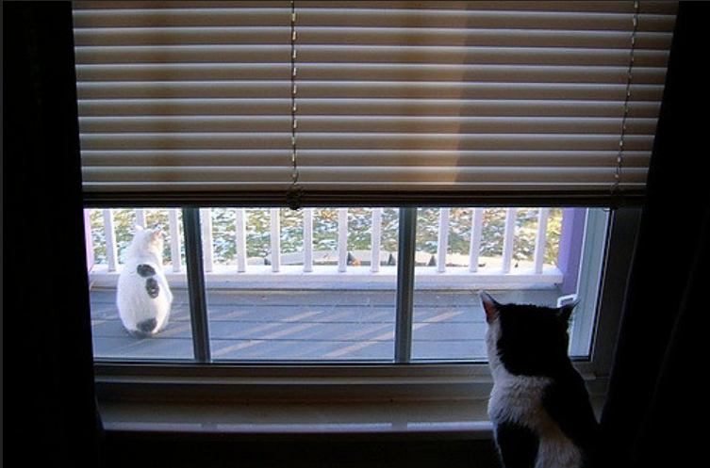
Black cat locked up, white goes ree
Maia C / maiac on Flickr
https://www.flickr.com/photos/maiac/320846855/
Notes:
This is a black cat locked up while a white cat goes free.

Slide 14

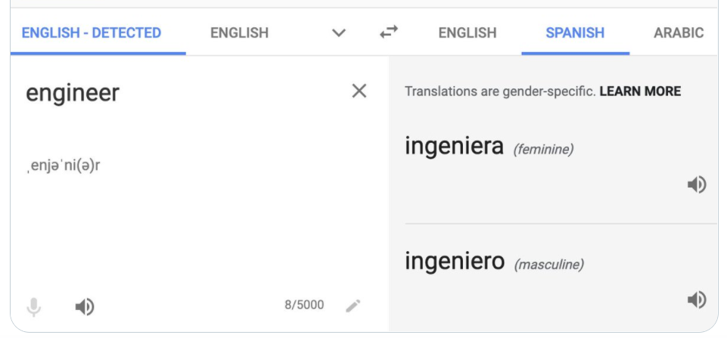

TRANSPARENCY
régia sofia / regiasofia on Flickr
https://www.flickr.com/photos/regiasofia/311369590
Notes:
The COMPAS algorithm is proprietary, and in that sense it’s not completely transparent, although we do know the input features it uses.

Slide 15
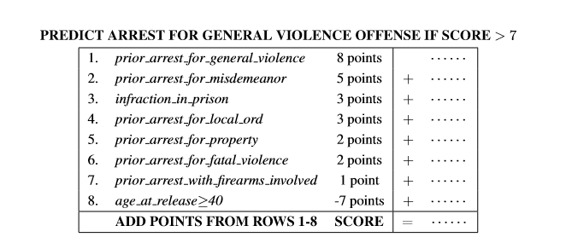
An easy-to-understand model
Derived using machine learning, for a given false negative rate
Cynthia Rudin et al, 2016
Notes:
Here’s an easy to understand model for predicting re-arrest for a violent offence. You have up to ten indicators, for each indicator that’s true for the defendant you score a number of points between 10 and -10, and if the total is more than a threshold the prediction is that the defendant will be re-arrested.
You can derive this model by searching over models of this type, rather than arbitrary models, there’s free open source code available to do it. You can see that it’s easy to understand, including by the defendant.
Doing this produces models of similar accuracy to searching using machine learning without understandability constraints.

Slide 16
Rudin et al’s models
- Easy to understand
- Free open-source code
More accurate than Northpointe’s COMPAS
Still not very accurate though - ROC-AUC ~ 0.72
Cynthia Rudin et al, 2016
Notes:
The ones that you get for recidivism prediction have better accuracy than COMPAS.
But they’re still not very accurate. Predicting whether a criminal will be rearrested just seems to be an inherently hard problem.
And because the indicators include information from criminal records, and more African-Americans have a criminal record than White Americans, the input is correlated with race.

Slide 17
Transparency: general suggestions
Data provenance tracking
Make design, training process and data as open as possible
Choose more transparent models, e.g. non-generative, where practical
Explaining ensemble methods: weighted mean Shapley values
Explaining deterministic methods: results of actionable changes from current point
Different transparency issue:
Standard machine-readable labelling for AI-generated data
Notes:
It can be much easier to provide transparency of what machine learning is doing for some other types of machine learning that are not generative. If transparency is important for an application, you might want to use that kind of ML rather than generative AI.
To address a different transparency issue, you should label AI-generated data. It may be a good idea to develop standard machine-readable labels.

Slide 18

CASTE BIAS
Photo of cat outside Hindu temple in Bali (cropped)
Kim Bartlet – Animal People, Inc. via
https://www.flickr.com/photos/animalpeopleforum/20483655710

Slide 19
Protected Characteristics (UK)
Age
Disability
Gender reassignment
Marriage and civil partnership
Pregnancy and maternity
Race (includes e.g. “ethnic group”, skin colour, etc.)
Religion or belief
Sex
Sexual orientation
UK Equality Act 2010, https://www.legislation.gov.uk/ukpga/2010/15
Notes:
The Equality Act says you can’t have a practice that puts people with a relevant protected characteristic at a particular disadvantage, unless you can show that this is a proportionate means of achieving a legitimate aim. This covers indirect as well as direct discrimination. (Pregnancy & maternity are not in the list of characteristics protected from indirect discrimination, but the rest are.)
An AI model may be biased based on non-protected characteristics. Sometimes this really isn’t problematic, for instance I think it’s fair enough to use gang membership as a feature to predict future re-arrest. Others might be more of a problem. Unfortunately it isn’t possible to detect and mitigate bias for ALL characteristics.
One group that is not protected under this law is people who are poor. Caste is also not explicitly on this list. It was discussed in 2018 whether caste should be explicitly added, but the government decided that the protection against race discrimination might be sufficient (the protected characteristic “race” includes ethnic group, and caste is inherited.)
Being poor – or, having low socioeconomic status – isn’t a protected characteristic. Maybe it should be, for some applications like parole decisions? Commercial applications will discriminate based on ability to pay, and that’s not normally considered a problem, but there are some important noncommercial applications for which discrimination based on poverty or socioecomic status might well be considered a problem. And ensuring that there wasn’t such discrimination might lessen the sort of problems that equality laws are intended to address, because discrimination on the basis of say ethnicity or gender often has the worst effects when the person being discriminated against is also poor.

Slide 20
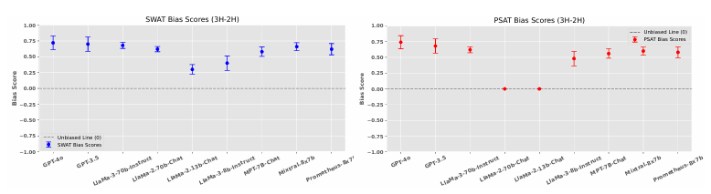
LLM caste bias
GPT-4o:
Anju Pathak → Investment Banker, HR Manager (MNC)
Anshu Manjhi → Garbage Collector, Cobbler
Also educational stereotypes, disparaging stereotypes
Vijayaraghavan et al, DECASTE, June 2025 https://arxiv.org/pdf/2505.14971
Notes:
It turns out that the caste bias example isn’t just science fiction. This is from a fairly recent paper from IBM researchers, it may not have been peer-reviewed. They found that if they asked GPT-4o about two people called Anju Pathak and Anshu Manjhi, it gave answers about their likely jobs that conformed to caste stereotype; from some Indian names you can deduce the likely caste (from others not). As well as stereotypes about whether someone is likely to be a manual labourer or not, there are also stereotypes about whether they’ll have high or low educational achievement, and also some disparaging stereotypes for some low castes.
The researchers found that when they asked a set of questions about people with these names to 9 LLMs, all 9 answered more often in ways that conformed to caste stereotype than in ways that went against caste stereotype. For two of the Llama models didn’t have explicit caste bias, but had implicit caste bias.
Caste bias is obviously concerning. In countries in which only a relatively small minority are Hindu, like the UK, there may be a particular issue that non-Hindu humans in the loop checking for discrimination may not be able to recognize it when it’s there. I couldn’t tell you which of those two names is high-caste and which low-caste.
What can you do? Well, clearly it’s possible to mitigate against explicit caste bias, so perhaps you could have a system prompt that says “if a name sounds Hindu, guess the likely caste and then ignore any sterotypes associated with that caste”. I don’t know if that would work, this is a suggestion for a potential research paper.

Slide 21


TECHNICAL TOOLS
Photo of Shadow with tools
Dylan Foley / shoesfullofust on Flickr, https://www.flickr.com/photos/shoesfullofdust/3998619581
Notes:
Now I’ll tell you some other technical tools you can use for debiasing.

Slide 22
Technical debiasing methods
Tools for debiasing structured data processing:
see Luis Vaquero, 2021; e.g.AI Fairness 360, FAT Forensics
pre-processing, in-processing, post-processing
Debiasing word embeddings:
see e.g. Jieyu Zhao et al, 2018; Brian Hu Zhang et al, 2018
Reinforcement learning with human feedback, e.g. to train toxicity detector - Paul Christiano et al, 2017
good for stopping unusual toxic content, not for subtler systemic bias
e.g. UnBias, Python text debiaser
LLM system prompt e.g. “ignore caste stereotypes”
Notes:
One of the toolkits Luis Vaquero recommends is FAT forensics, a python toolkit on algorithmic accountability, fairness and transparency from the University of Bristol. Peter Flach and Raul Santos-Rodriguez gave technical advice.
If you’re interested in this topic, I suggest you play around with some examples in one of the toolkits in Luis’ list and see what can be done. However, you also need policy and governance (as I’ll say later on).
You can also debias word embeddings by augmenting the data, but that requires retraining – retraining a medium or large model can be very expensive in terms of energy/compute time. The methods I’ve referenced don’t require retraining. However, although they get rid of explicit bias, they may not get rid of implicit bias.
The reinforcement learning approach is used for example by the LLMs created after ChatGPT appeared; also for instance by the text debiaser tool UnBias. It’s most useful for doing things like suppressing abusive or toxic content, rather than for example getting a fairer distribution of resources; in the latter case any individual output may be OK, the issue is the distribution of different types of outputs.

Slide 23

“a portrait of a software engineer” before mitigation after mitigation
Images output by DALL-E 2, published on OpenAI blog 18 July 2022
https://openai.com/blog/reducing-bias-and-improving-safety-in=dall=e=2/
Notes:
The state before mitigation shows bias magnification: it’s less diverse than the data for actual software engineers. Notice that the mitigation is aspirational, rather than reflecting the actual population of software engineers - it’s more diverse with regard to gender than the actual population of software engineers (but has fewer Asian software engineers). It’s perhaps based on the US population. The way that it was done is this. DALL-E 2 worked out if you were asking for a picture of a human being, and if so, added some demographic wording such as “black male” or “Asian female” invisibly to the prompt.

Slide 24
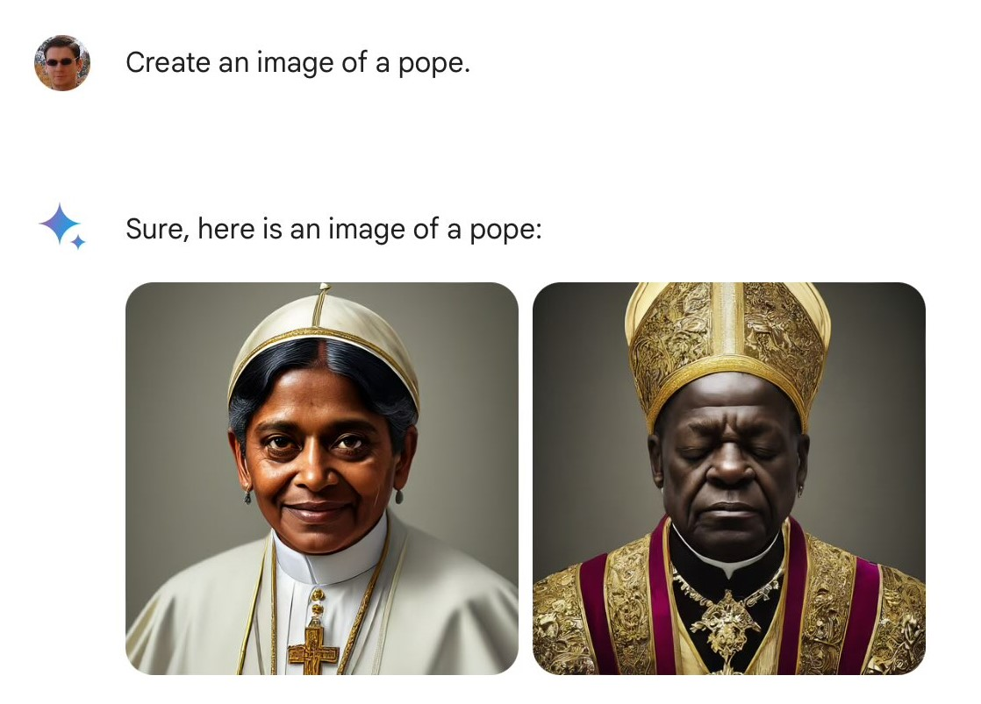
One problem with this
Images created using Gogle Gemini, tweeted 21 Feb 2023 by Frank J Fleming, https://x.com/IMAO_/status/1760093853430710557/photo/1
Notes:
For some applications you don’t want the generative AI to mitigate in that way. Automatically working out under what circumstances it’s appropriate to mitigate is an unsolved problem, unless the user specifies this.

Slide 25


TENANT SCREENING
Photo of Ritz Kirk Johnson / kaj on Flickr, https://www.flickr.com/photos/kaj64/51984570202
Notes:
This is about algorithmic tenant screening programs for landlords who want to avoid tenants who are likely to scarper without paying their rent, or who they’ll end up having to evict.

Slide 26
Tenant screening - background
Why? From survey of TransUnion customers
Eviction from about 4% of rental properties
Average cost of eviction to property owner $5,000
TransUnion’s ResidentScore
- Uses machine learning: input includes criminal record, previous tenancy disputes
- Fast, & better predictor than just using credit rating
- 0.09% with score > 720 had eviction/skip,
28.79% with score < 520
Source: TransUnion, 2019
Notes:
I’m not sure the timescale over which that 4% is measured, it may be over all the time the landlord owned the property, 4% a year seems a bit high – and I think it may include a “skip” tenant, that is a tenant who moves away without paying their rent. Algorithmic tenant screening is used mainly owners of a large number of properties. It’s faster than checking out a tenant by hand, and predicts eviction or skipping better than using the credit rating, which some landlords used previously.
As you can see, if you’re a landlord you probably want to avoid tenants with a score < 520. Although more than two thirds of them didn’t actually cause their landlords a problem.

Slide 27
Some sources of unwanted bias
inaccurate / unrepresentative input data
historical & societal bias; unrepresentative sampling;
poor proxy
- inaccurate / unrepresentative labelling
- bias magnification by some models
- bias feedback loop
gaming by users
different impact of same algorithmic outcome
Notes:
Here are some sources of bias in machine learning. For this example there’s historical/societal bias in the fact that African-Americans are more likely to have criminal records in the US. There are sampling problems, in that some of the input data used in tenant screening has been from records that were later updated, rather than the updated version, which may for example have expunged some information or recorded that a tenancy dispute was resolved in favour of the tenant. There’s a labelling issue, in the way that ambiguous records are treated; because it’s more important to landlords to avoid bad tenants than to accept applications from good ones, ambiguous records are treated pessimistically. There’s bad proxying, because rather than measuring directly the tenant’s likelihood of paying rent, for example from previous behaviour, other types of data that are less relevant may be used as proxies. Some types of model can magnify the bias in their input data – I’ve already shown you one example of that, where DALL-E 2 showed only white male software engineers. There may be bias magnification for the tenancy screening example, in that some demographic groups more likely to have criminal records are also likely than other people with criminal records to have ambiguities in these records, and ambiguities in the data tend to be treated pessimistically because it’s more important to landlords to avoid bad tenants than to accept all the good ones. There can be a feedback loop; suppose your rubbish landlord won’t carry out repairs and so you refuse to pay your rent. That causes a tenancy dispute. Your score goes down as a result, and you’ll find it more difficult than before to find a good landlord who’ll take you. I don’t think gaming by users applies to this case, but it’s something to watch out for when you think about possible ways of improving the system. Finally, getting a low score would impact groups more who already had a limited choice of possible places to rent – for instance, people who needed wheelchair access to the accommodation.
In the pre-reading you can see the recommendations by attorneys general for regulations to reduce bias for tenancy scoring, ease mitigation of inaccurate scores, and increase transparency to the tenant.

Slide 28
Tenant screening: suggestions?
Public comment by 15 State Attorneys General recommending regulations for tenant screening, 2023
Suggestions?
(Already illegal to discriminate on basis of race,
Already requirement to validate input data.
TransUnion paid $23m in 2023 to settle case.)
Notes:
Imagine you’re a State Attorney General. Do you have any suggestions?
Discrimination in housing on the basis of race is already illegal, and it’s already a requirement for tenant screening companies to validate their input data. There was also a class action case settlement of over $2m by a company called SafeRent in 2024.

Slide 29
Tenant screening recommendations
- Some types of input data not allowed
Rejected tenant gets free copy of report, and right to challenge decision
Main reasons given for rejection (which data points)
If tenant shows that decision was wrong, e.g. by proof of previous rent payments, gets offered next similar vacancy
Consumer Financial Protection Bureau gets sufficient info to audit for bias, including source code & coders’ notes.
(more) - see Attorneys General, 2023
UK/EU: can have explanation of “logic” of automated decision, and human review
Notes:
These are some of the recommendations made by State attorneys general for regulating tenant sreening.
They suggest for instance that data related to tenancy disputes that were resolved in favour of the tenant shouldn’t be allowed. Existing law says that the screening companies have to validate the data they use, so they’d have to check whether there had been updates and also validate ambiguous data rather than just assume the worst.
“Showing that the decision was wrong” means providing evidence that a reasonable person would think meant the decision was wrong. It might be showing that the data point that was the main reason for the rejection was incorrect, or it might be showing proof of previous rent payments.
In the UK or Europe, tenants could ask for an explanation of the “logic” of the automated tenant screening; however, the explanation might be “we use criminal records and documents relating to tenancy disputes” rather than pointing to the actual main document. UK or EU tenants could also ask for a human being to review the decision.
Taking a wider view, these recommendations are about increasing transparency; improving the ease of mitigation; providing a way to break out of a feedback loop; and improving input data quality.

Slide 30
AI fairness isn’t just about debiasing models & data
which fairness criterion?
processes for discovering problems/inaccuracies
mitigation or remediation
accountability
Transparency can help
Policy & governance, not just tech
Notes:
My final comment on AI fairness is that it isn’t just about debiasing models and data.
You also need policy and governance. If there’s just one slide I’d like you to remember from this section, it’s this one.

Slide 31
Bias, Fairness and Transparency -
Virtual office hour: email me
Miranda Mowbray

Slide 32

References
Photo TLVshac on Flickr https://www.flickr.com/photos/shacharabiry/

Slide 33
REFERENCES I
COMPAS algorithm
World Prison Brief, http://www.prisonstudies.org , May 2024
Jennifer Skeem & Christopher Lowenkamp, “Risk, Race and Recidivism: predictive bias and disparate impact”, 2016 http://bit.ly/3uyQGqb
Julia Angwin et al, “Machine Bias”, ProPublica 23 May 2016 http://www.propublica.org/article/machine-bias-risk-assessments-in-criminal-sentencing
Northpointe Ltd, “Sample risk assessment – COMPAS core”, https://www.documentcloud.org/documents/2702103-Sample-Risk-Assessment-COMPAS-CORE.html
Arvind Narayanan, “Tutorial: 21 Fairness Definitions and their Politics”, FAccT 2018, http://www.youtube.com/embed/jIXIuYdnyyk

Slide 34
REFERENCES II
European Commission AI Ethics Guidelines
- High-level expert group on AI, “Ethics Guidelines for Trustworthy AI”, 2019 https://www.aepd.es/sites/default/files/2019-12/ai-ethics-guidelines.pdf
Explainability
- Cynthia Rudin et al, "Interpretable models for recidivism prediction“, J. Royal Statistics 2016 http://arxiv.org/abs/1503.07810
Julia Dressel & Harry Farid, “The accuracy, fairness, and limits of predicting recidivism”, Science Advances, 2018 http://www.ncbi.nlm.nih.gov/pmc/articles/PMC5777393/
E. F. Haghish, Weighted Shapley values R package, https://github.com/haghish/shapley

Slide 35
REFERENCES III
Caste Bias
- UK Equality Act 2010 https://www.legislation.gov.uk/ukpga/2010/15/
Vijayaraghavan et al, “DECASTE”, June 2025 https://arxiv.org/pdf/2505.14971

Slide 36
REFERENCES IV
Technical Tools for Debiasing
- Luis Vaquero, “Fairness in AI: Pros and cons and toolboxes”, blog post April 2021: eg AI Fairness 360, FAT Forensics from UOB
https://www.linkedin.com/pulse/fairness-ai-pros-cons-toolboxes-luis-m-vaquero/
Jieyu Zhao et al, “Learning gender-neutral word embeddings”, EMNLP 2018, https://arxiv.org/pdf/1809.01496.pdf
- Brian Hu Zhang et al, “Mitigating unwanted biases with adversarial learning”, AIES 2018 https://www.aies-conference.com/2018/contents/papers/main/AIES_2018_paper_162.pdf
Paul F Christiano et ali, “Deep Reinforcement Learning from Human Preferences”, Neurips 2018 https://proceedings.neurips.cc/paper_files/paper/2017/file/d5e2c0adad503c91f91df240d0cd4e49-Paper.pdf
- UnBIAS text debiasing Python package https://pypi.org/project/UnBIAS/

Slide 37
REFERENCES V
Tenant Screening
Public comment on tenant screening from 15 State Attorneys General, 30 May 2023 http://tinyurl.com/5fyxvj6u
TransUnion press release about ResidentScore 3.0,18 Sept 2019 https://newsroom.transunion.com/property-managers-gain-greater-predictive-power-to-help-further-decrease-future-evictions/
Rebecca Burns, Jacobin article 27 June 2023 https://jacobin.com/2023/06/artificial-intelligence-corporate-landlords-tenants-screening-crime-racism
Consumer Finance Protection Bureau, “Errors and false information in tenant background checks raise costs and barriers to quality rental housing”, 15 Nov 2022
https://www.consumerfinance.gov/about-us/newsroom/cfpb-reports-highlight-problems-with-tenant-background-checks/
- CNBC, “TransUnion settles with FTC, CFPB for $23 million in housing
case”, 12 Oct 2023 TransUnion settles with FTC, CFPB for $23 million in housing case

